Slide 1
FHIR Implementation Guides
Implementation Guides:
Are packages of FHIR conformance resources relevant to solving a particular interoperability need
Also include additional human-readable documentation to guide implementation
Provide support for validation of solutions that claim conformance with the IG
Can build on other implementation guides
Are defined by a FHIR ImplementationGuide resource

Slide 2
Conformance Resources
Terminology
Code System
Value Set
Naming System
Content
Structure Definition
Data Element
Behavior
Operation Definition
Search Parameter
Conformance
Misc.
Implementation Guide
Test Script
Structure Map
Concept Map

Slide 3
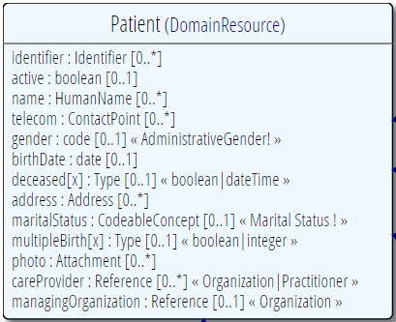
Profiling a resource
Demand that the identifier uses your national patient identifier
Limit names to just 1 (instead of 0..*)
Limit maritalStatus to another set of codes that extends the one from HL7 international
Add an extension to support “RaceCode”
Note: hardly any mandatory elements in the core spec!

Slide 4
What can profiles do?
Constrain cardinality
Constrain codes (value sets & binding strength)
Constrain & profile types
Add additional invariants
Indicate what must be supported
Define reference resolution
Add additional narrative guidance

Slide 5

CodeSystem vs. ValueSet
“Dante’s deadly sins”
Pride
Envy
Wrath
Sloth
Avarice
Gluttony
Lust
Takes concepts from…
Definition of terms
An enumeration of terms
“CodeSystem”
“ValueSet”
Example: SNOMED-CT
Example: “Childhood diseases”

Slide 6

“Special” cases
No need to write them all down!
Takes concepts from…
“All words under B”
“All words in the
Merriam-Webster dictionary”
“Words for ‘nerd’”
Bookworm
Geek
Grind
Weenie
Wonk
Dink (slang)
Dork (slang)
Takes concepts from…
Takes concepts from…
Can take concepts from multiple codingsystems

Slide 7
Conformance levels
Fixed: You must use this value set if you send the element.
If it’s a CodeableConcept, you can sent translations too
Extensible: You must use a code from this value set if one applies
Preferred: Recommend using this code system, but ok if you don’t
Example: No recommendation, may be incomplete

Slide 8
Slicing
Schematic view of Composition (aka a Document header)
Composition
type: CodeableConcept
Section
code: CodeableConcept
content: Resource(Any) 0..1
0..*
Slicing = constraining a repeating element
Base Composition has 0..* “Sections”
Section has 0..1 element with content

Slide 9
Slicing into a CCD
Composition
type = “34133-9” “Summarization of
episode note”
Section
code = 42348-3 (“Advance directives”)
Section
code =11450-4 (“Problem list”)
…
Section
code = 18776-5 (“Treatment plan”)
“Slice” the repeating sections into a fixed set of profiled sections.
“code” is fixed and is called the discriminator

Slide 10
CapabilityStatements
There’s a resource for documenting conformance to FHIR
Can be used for:
Stating how a specific system instance behaves
Defining how a software system is capable of behaving (including configuration options)
Identifying a desired set of behavior (e.g. RFP)
To declare themselves “FHIR Conformant”, a system must publish a CapabilityStatement instance

Slide 11
CapabilityStatements in IGs
Used to define expected capabilities of each “system” role
What resources they support
Including what profiles they must support
What operations they support
Can include SHALL/SHOULD/MAY requirements

Slide 12
How to get system capabilities
CapabilityStatement is again, just a Resource
Any FHIR server will publish his own CapabilityStatement at the “metadata” endpoint
A FHIR server may store and publish any number of additional CapabilityStatement resources, so you can refer to them
Validatable by automated testing
Notes:
Conformance registry could be used for discovery of participants in a regional exchange, means of advertising system capability, etc.
No tools yet for authoring – volunteers?

